Slide 1
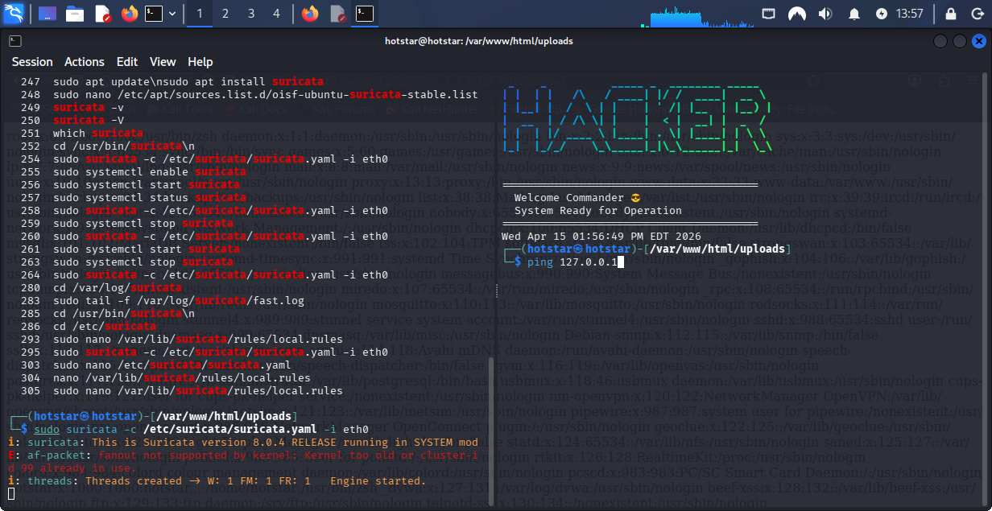
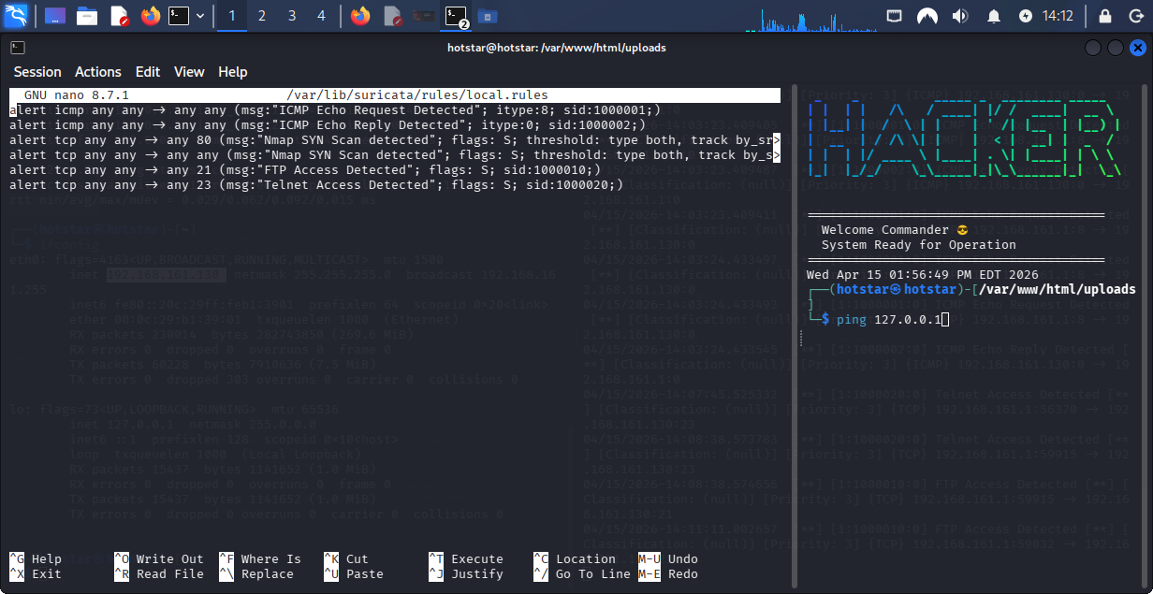
Suricata started and rules file

Slide 2
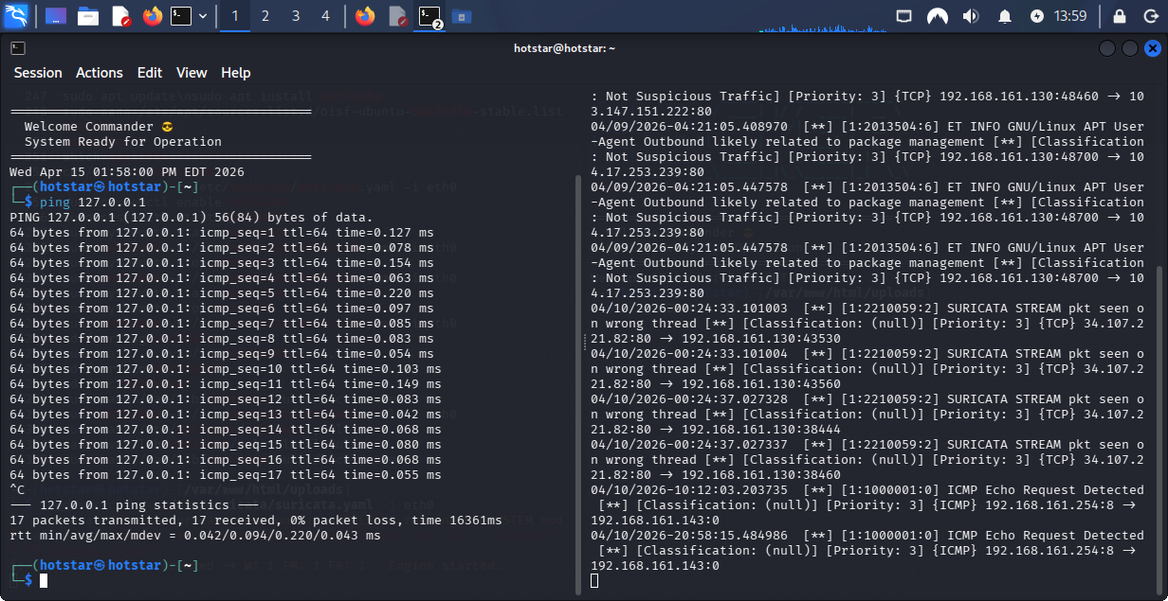
Alert generated at fast.log

Slide 3
Deliverables
Commands used:
ping
Nmap –sS –p 21
telnet
ftp
nmap
FTP/Telnet credential exposure is the highest priority as it leads to privilege escalation and may cause data leakage

